Slide 2
Chapter 1
Computer Networks and the Internet

Slide 3
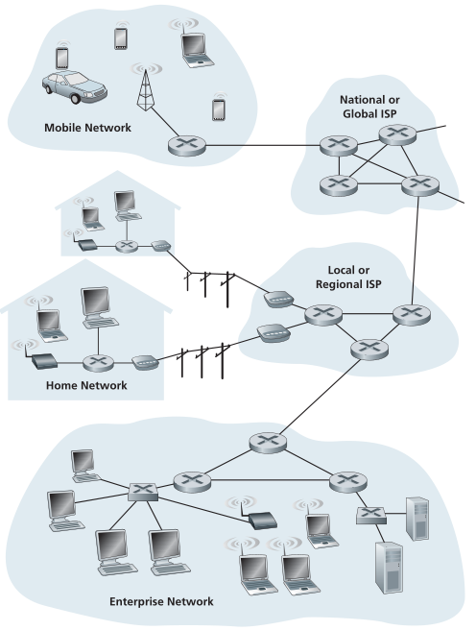
The Internet?
What you’ll learn about the Internet in this course
Guiding principles
Framework for understanding today’s and tomorrow’s networks
What access network technologies do you know of?
What network technologies transmit data between cities?
Notes:
Hosts, access networks, backbone networks, home networks and IoT
What access network technologies do you know?
- cable, dsl, fiber
How is data transmitted between cities?
- copper, fiber, microwave

Slide 4
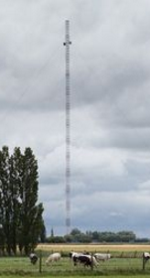
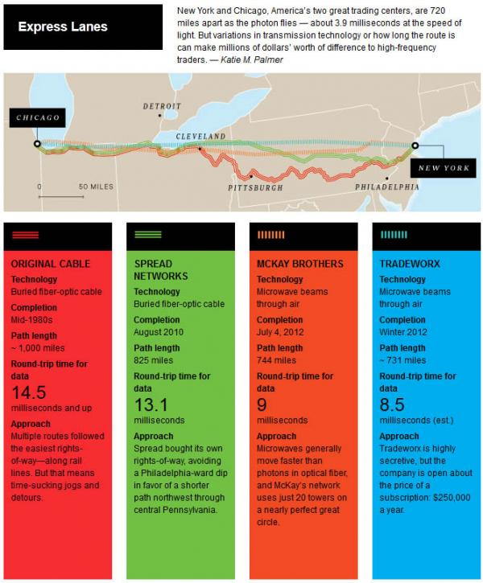
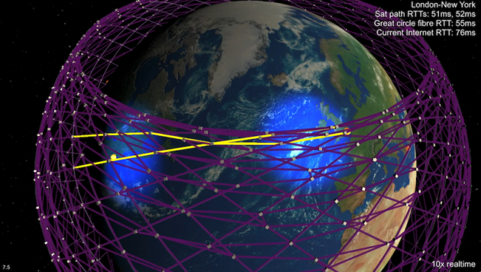
The quest for low latency
Notes:
Hosts, access networks, backbone networks, home networks and IoT
What access network technologies do you know?
- cable, dsl, fiber
How is data transmitted between cities?
- copper, fiber, microwave

Slide 5
Communication Example
Setup
Form 6 groups
Only adjacent groups can speak to each other
Begin by contacting your neighbors to learn their functionality
Goal
Send message from the sender to the destination
S
R
R
D
S
R1
R2
D1
R3
D2

Slide 6
Network example follow-up
S
R1
R2
D1
Send 011000111101
to D1
R3
D2
What problems did our setup run into?
R1 did not know which path lead to D1: addressing and routing
R1 and R3 did not agree on number of bits in a packet: medium access and standards
R2 introduced errors: end-to-end reliability
Receive 4 bits and forward
Receive 6 bits and forward
Receive 4 bits
Flip bits so XOR to 0
Forward
Check that bits in message XOR to 1

Slide 7






Argument for layered architecture
Large system
Mail example:
Complexity
Mike Wittie
Montana State University
361 Barnard Hall
Bozeman, MT 59715
Entities
Devices
Functionality
Standards
Delegation
Modular design
IETF
W3C IEEE
End-to-end and hop-by-hop mechanisms
Open System Interconnect (OSI) stack

Slide 8
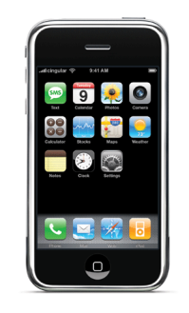

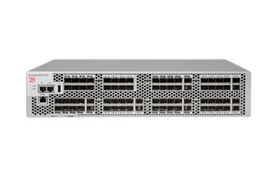

Internet protocol stack
Encapsulation:
Functionality:
Transmits:
7: Application
Snapchat
- services
7: Application
7: Application
- messages
TCP
- E2E comm.
4: Transport
4: Transport
4: Transport
- segments
- addressing, routing
IP
IP
- packets (datagrams)
3: Network
3: Network
3: Network
- medium access,
reliability
2: Data link
GSM
2: Data link
GSM
2: Data link
- frames
EM
EM
- modulation
1: Physical
1: Physical
1: Physical
- symbols
Notes:
Duplication of functionality – for example reliability
Need to share information between layers
The Global System for Mobile Communications (GSM)

Slide 9
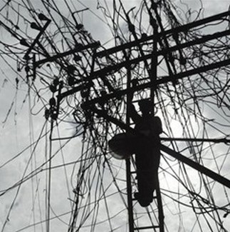
Growth of the Internet
How to connect Internet hosts?
For best end-to-end performance?
For lowest cost of connecting additional nodes?
Lower delay
To allow regional growth?
Global connectivity?
?
Notes:
All to all
Connect to closest
Cross links
Interchange points
Long haul, high capacity links

Slide 10
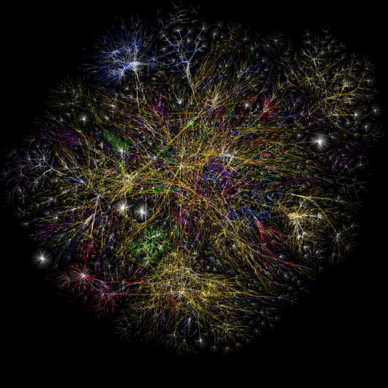
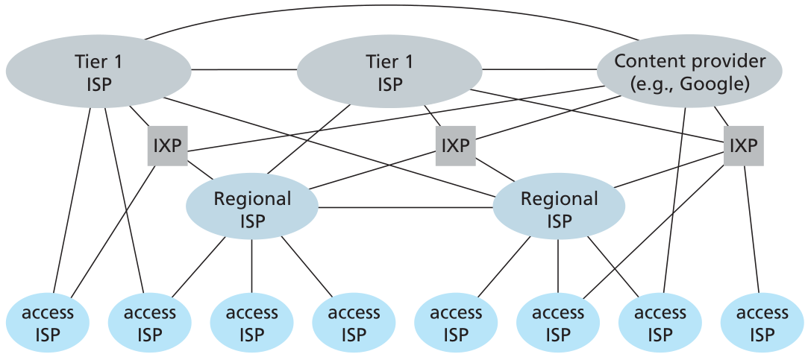
Internet Topology

Slide 11
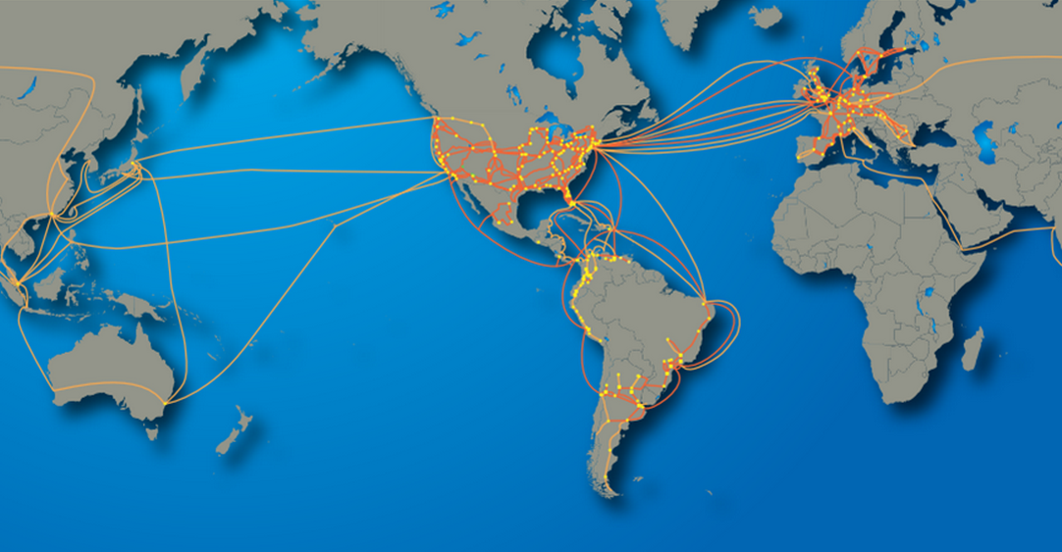
Tier-1 ISP: e.g., CenturyLink
POP: point-of-presence
to/from backbone
peering
…
…
…
…
…
to/from customers

